Slide 1
ENGI 301 Safe and Sound Vault PCB
JJ Tellez
Due 12/12/2023 @ 11:59pm

Slide 2
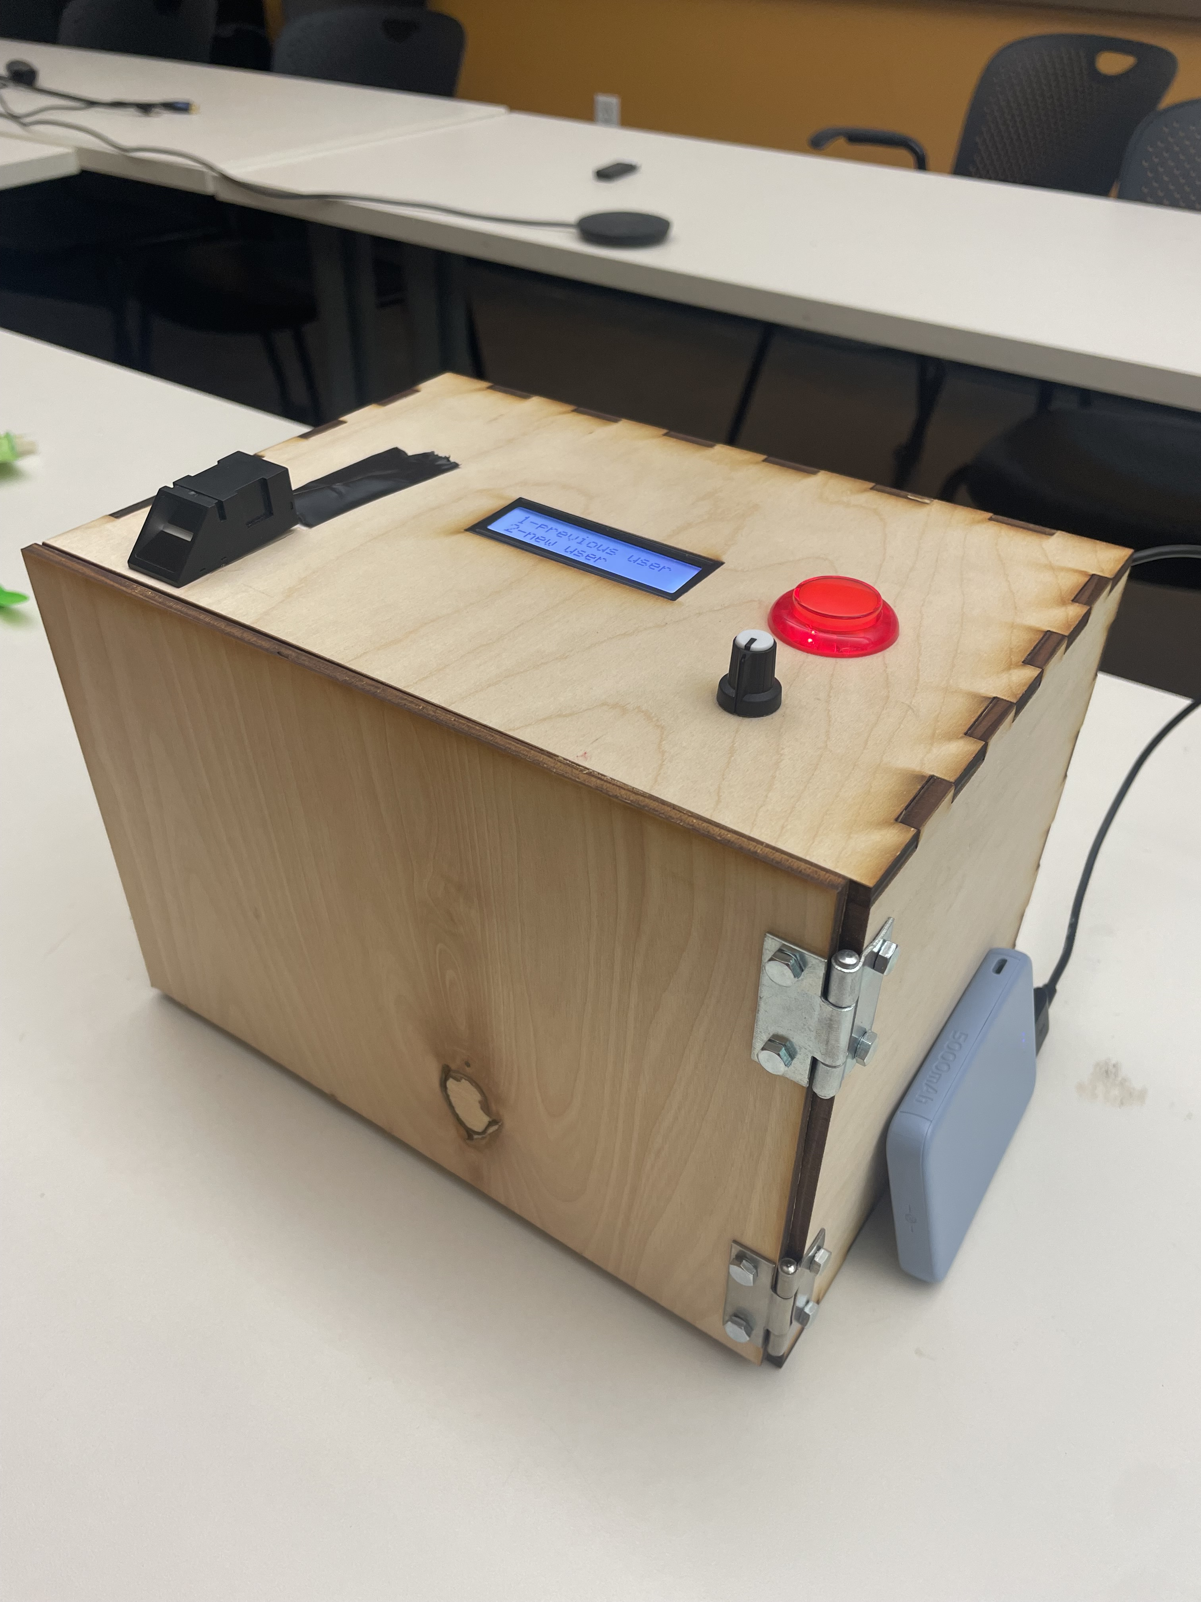
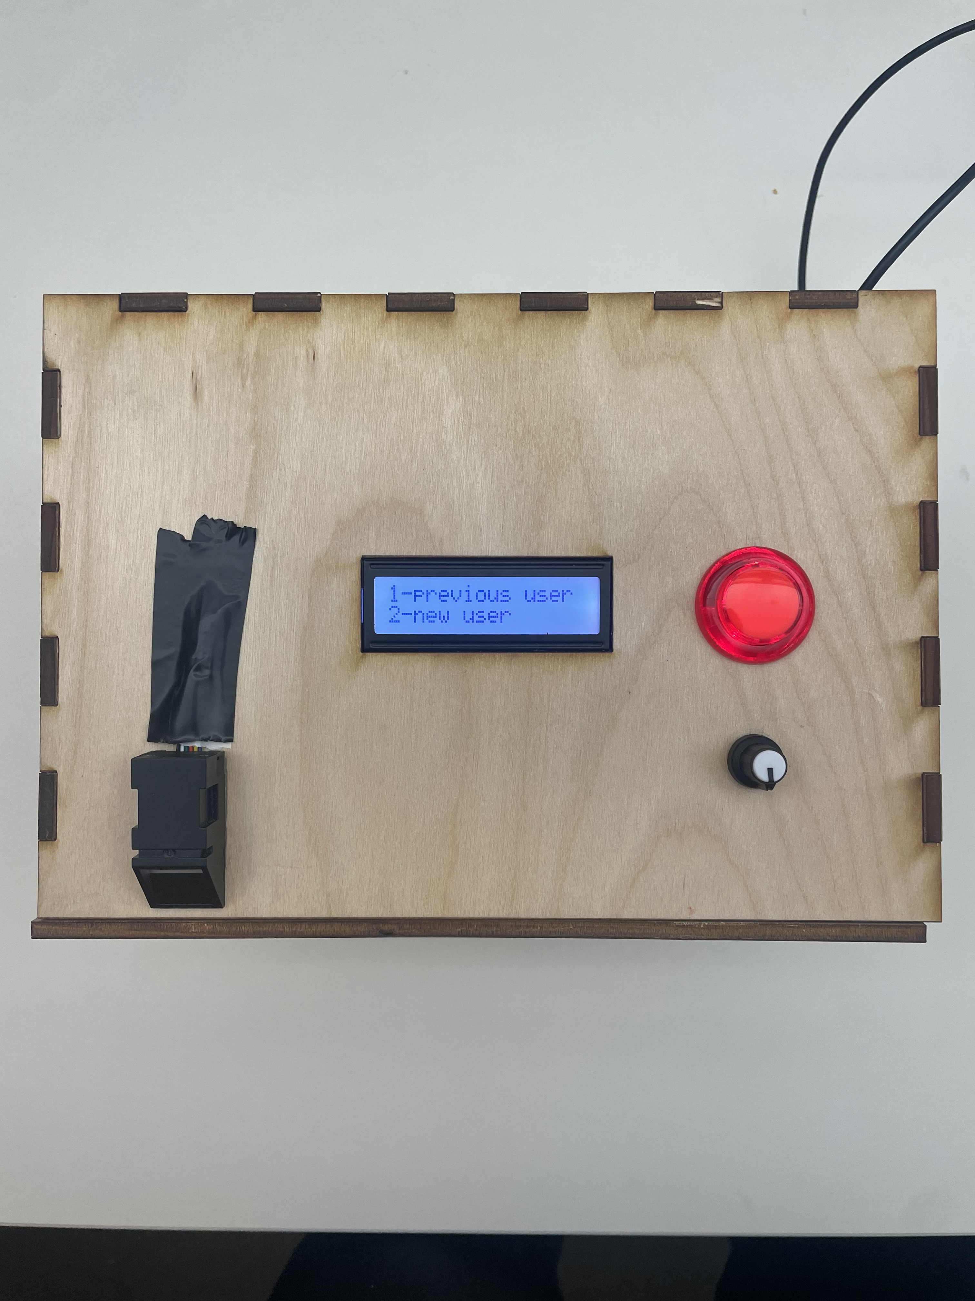
Background Information
Safe and Sound Vault Hackster
I’ve always wanted to have a place where I can store all my valuables in, but have never wanted to buy a vault.
Therefore, I decided to create a vault that can only be accessed by fingerprint and face recognition.
This project will be an addition to my previous project linked below. However, this project will focus on creating the specific PCB used rather than building and the wiring the components themselves (refer to huckster.io link for these instructions).
Hardware:
Fingerprint Sensor
Two Potentiometers (cap for the user interface one)
One Button
RGB LCD
Micro Servo
5V USB Battery

Slide 3
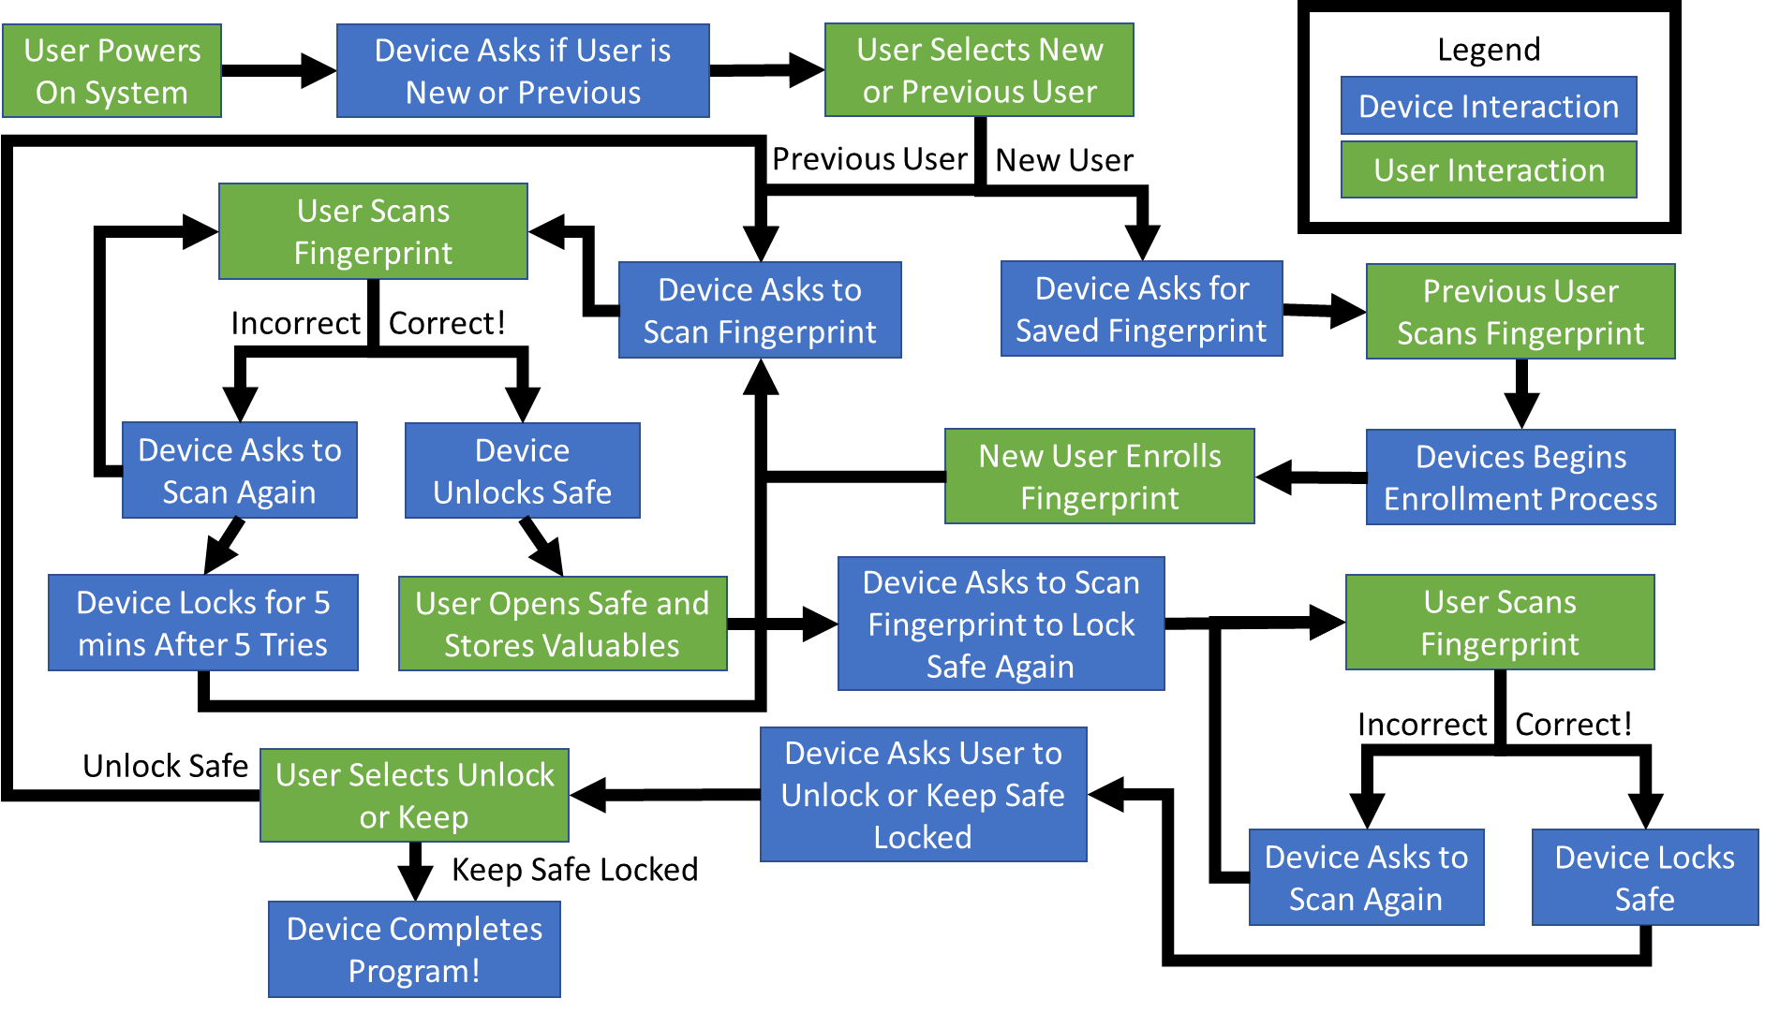
System Block Diagram

Slide 4
Mechanical Block Diagram
5”
1.5”
RGB LCD Screen
Pocket Beagle
4”
USB
Button
Finger print Sensor
Pot
Servo
1”
1”
FRONT
BACK

